Slide 1
FRESH CONCRETE

Slide 2
CONTENTS
WORKABILITY
DEFINITION
FACTORS AFFECTING WORKABILITY
SIGNIFICANCE
TESTS AVAILABLE FOR MEASUREMENT
SEGREGATION AND BLEEDING
DEFINITION – CAUSES AND EFFECTS,
MEASUREMENT, FACTORS EFFECTING THE PROPERTIES OF HARDENED CONCRETE, WATER/CEMENT RATIO, ABRAM’S LAW, POWER LAW, GEL SPACE RATIO, MATURITY CONCEPT

Slide 3
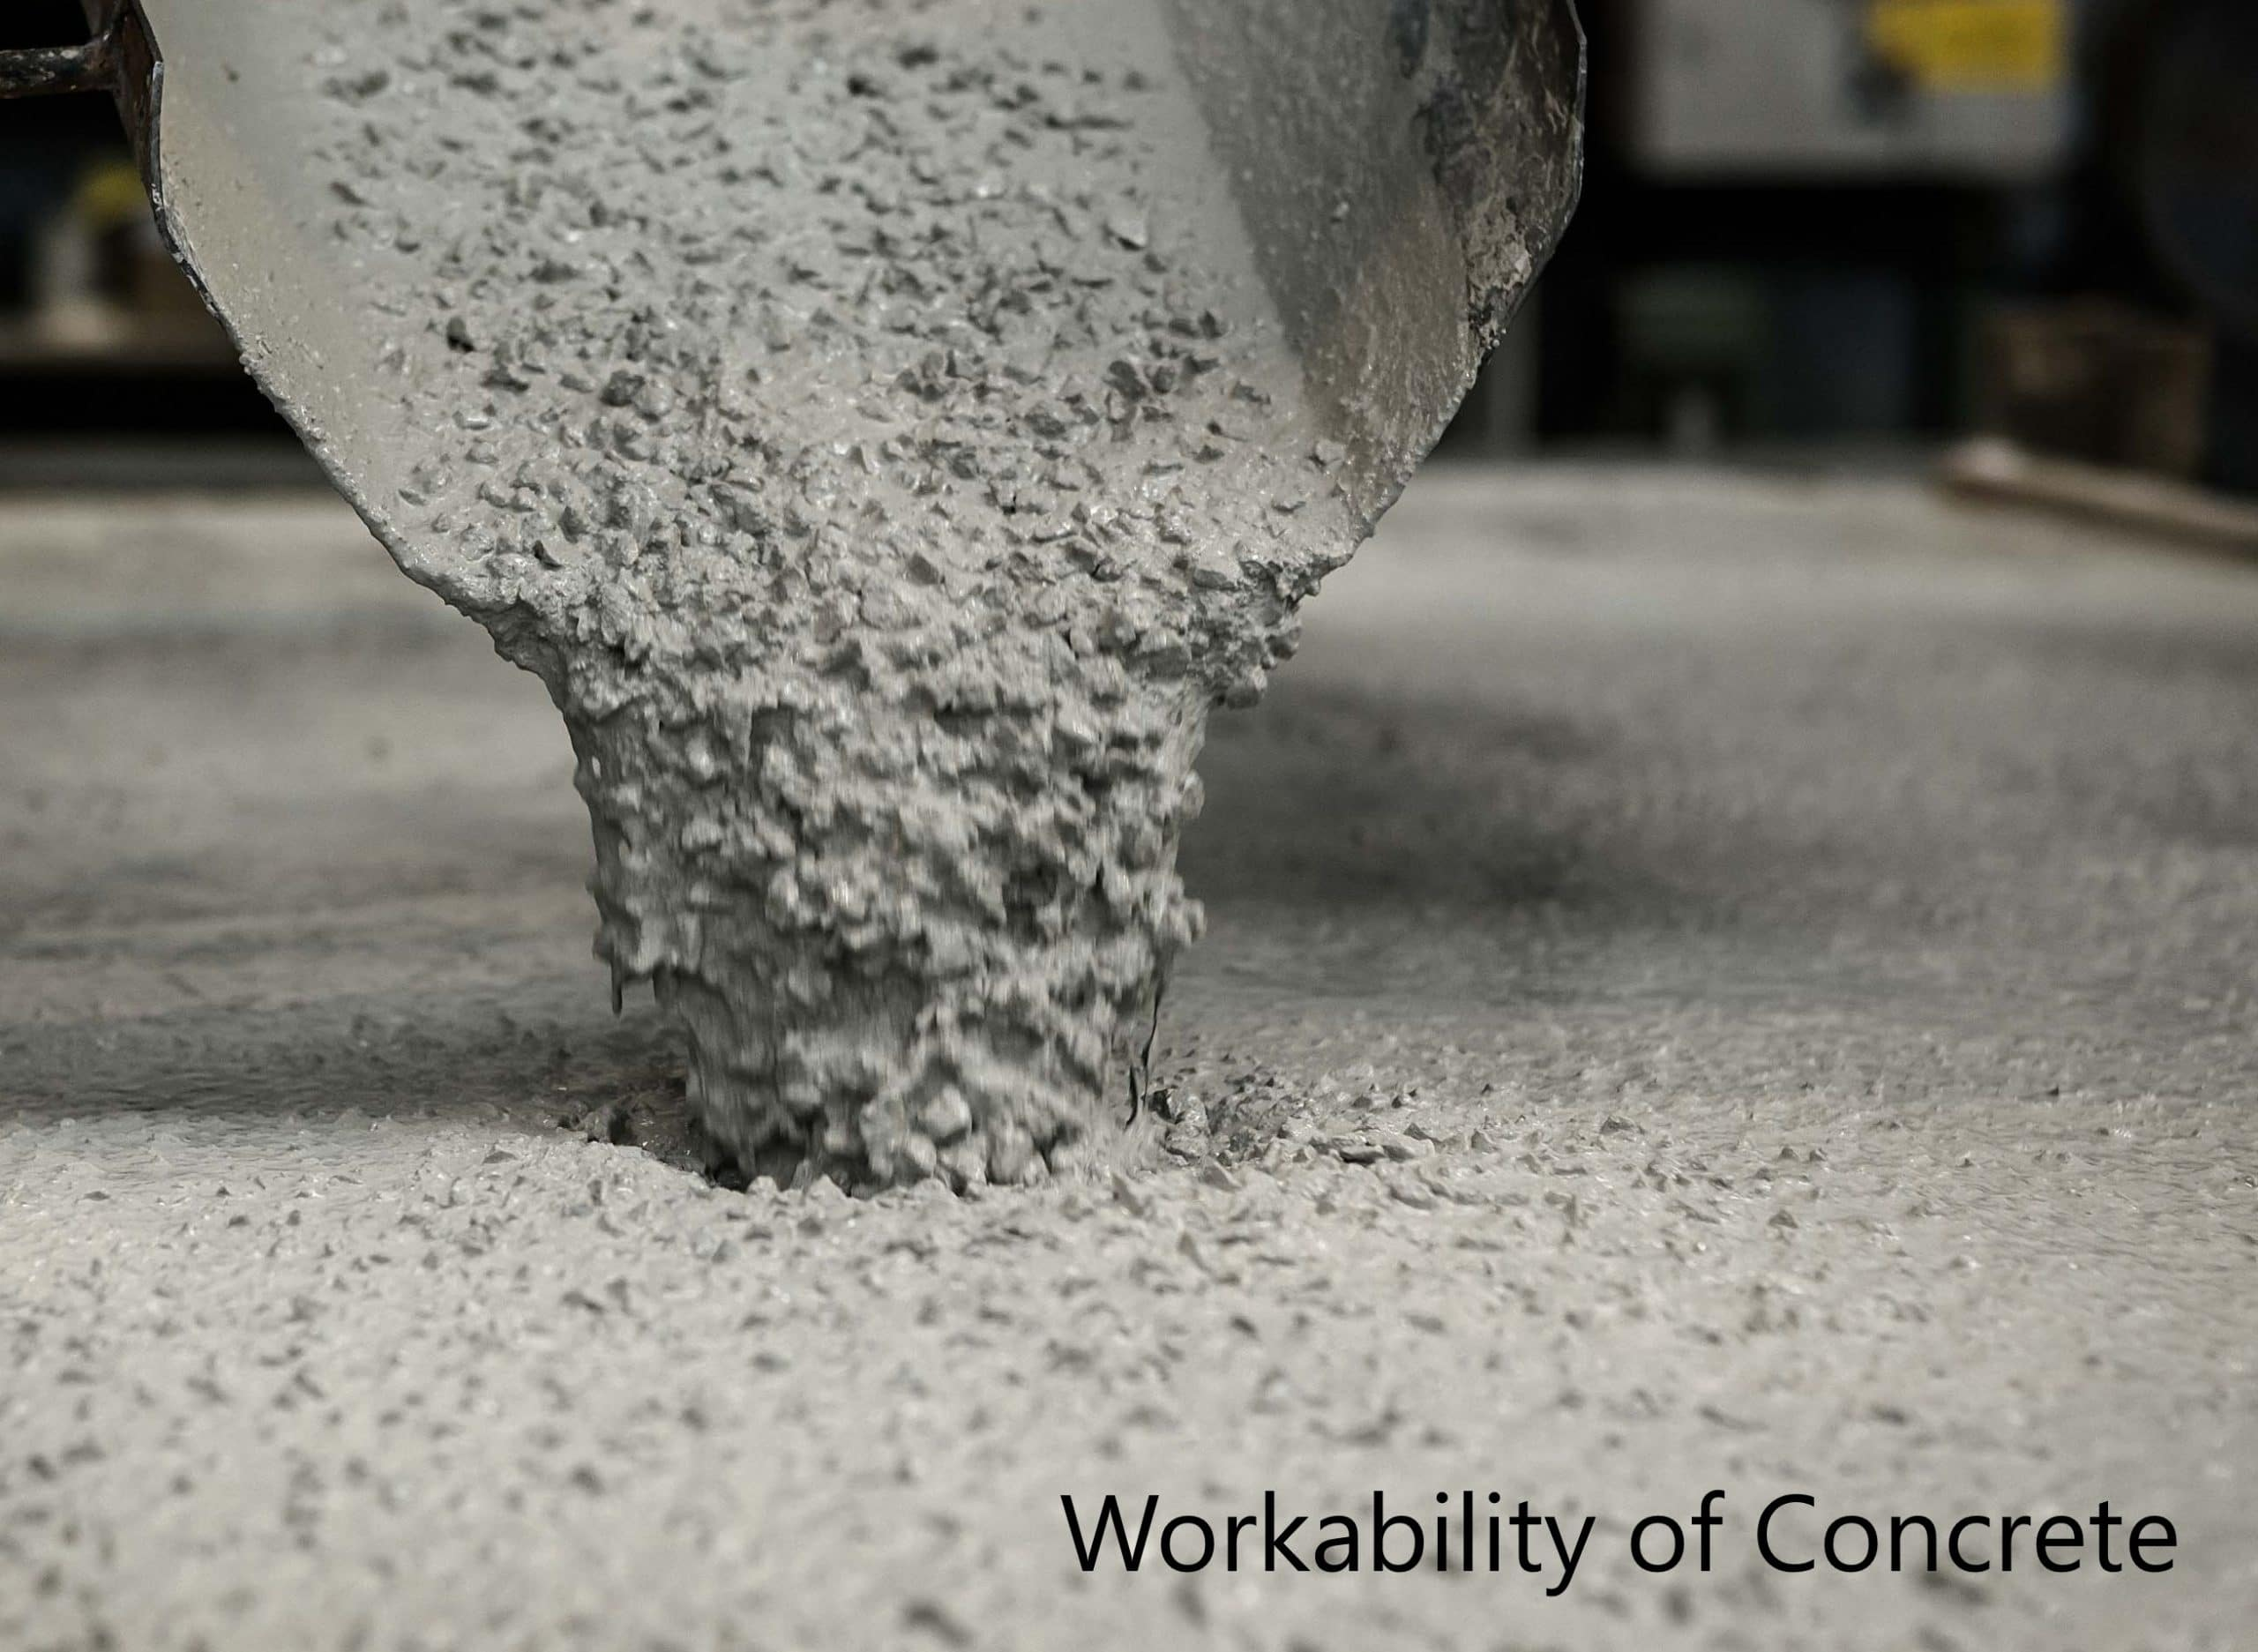
WORKABILITY:
Workability is a property of raw or fresh concrete mixture.
In simple words, workability means the ease of placement and workable concrete means the concrete which can be placed and can be compacted easily without any segregation.

Slide 4
Workability is a vital property of concrete and related with compaction as well as strength.
The desired workability is not same for all types of concrete.
More workability is required for a thin inaccessible section or heavily reinforced section rather than a mass concrete body.
Hence, we can’t set a standard workability for all casting works.

Slide 5
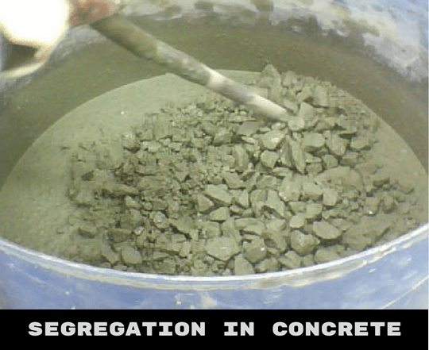
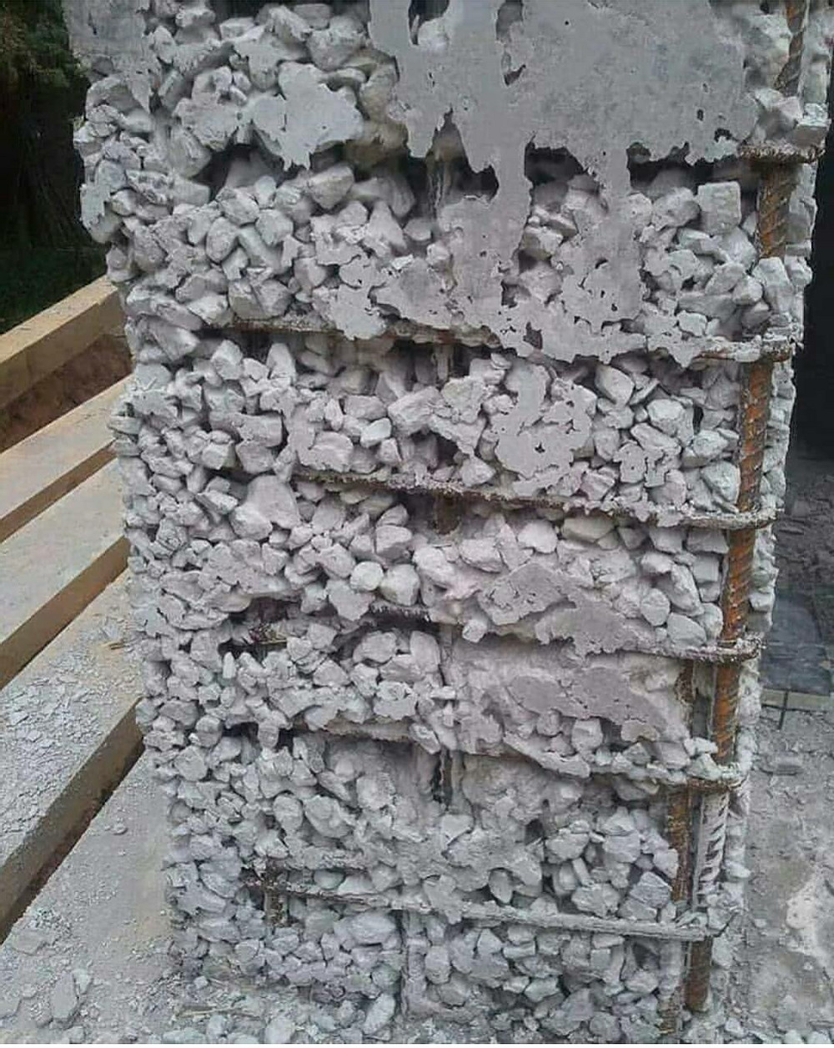

Slide 6
Compaction and workability are very close to each other.
Workability can also be defined as the amount of useful internal work necessary to produce full compaction.

Slide 7
ASTM C 125-93
Workability is the property determining the effort required to manipulate a freshly mixed quantity of concrete with minimum loss of homogeneity

Slide 8
American Concrete Institute (ACI) Standard 116R-90 (ACI 1990b)
Workability is that property of freshly mixed concrete or mortar which determines the ease and homogeneity with which it can be mixed, placed, consolidated and finished

Slide 9
Reason for Different types of definition
A variety is seen between definitions of workability because it is not very accurate scientific term like specific gravity or weight.
All definitions are qualitative in nature and personal viewpoint is reflected instead of scientific precision.
There are some other terms used to describe concrete as cohesiveness, consistency, flowability, mobility, pump-ability etc.
These terms have their specific meaning but they cannot be determined inaccurate number or unit.

Slide 10
Types of Workability of Concrete
Workability of concrete can be classified into following three types:
Unworkable Concrete:
An unworkable concrete also known as harsh concrete, is a concrete with a very little amount of water.
The hand mixing of such concrete is difficult. Such type of concrete has high segregation of aggregates. and it is very difficult to maintain the homogeneity of concrete mix.

Slide 11
Medium Workable concrete:
Medium workable concrete is used in most of the construction works.
This concrete is relatively easy to mix, transport, place, and compact without much segregation and loss of homogeneity.

Slide 12
Highly Workable Concrete:
This type of concrete is very easy to mix, transport, place and compact.
It is used where effective compaction of concrete is not possible.
The problem is that there are high chances of segregation and loss of homogeneity in highly workable concrete.

Slide 13
FACTORS AFFECTING WORKABILITY
Water content
Mix proportions
Size of aggregate
Shape of aggregate
Surface texture of aggregate
Grading of aggregate
Use of admixtures

Slide 14
WATER CONTENT
More the water cement ratio more will be workability of concrete. Since by simply adding water the inter particle lubrication is increased.
High water content results in a higher fluidity and greater workability.
Increased water content also results in bleeding.
Another effect of increased water content can also be that cement slurry will escape through joints of formwork.

Slide 15
MIX PROPORTIONS
Aggregate/cement ratio is an important factor influencing workability. The higher the aggregate/cement ratio, the leaner is the concrete. In lean concrete, less quantity of paste is available for lubrication, per unit surface area of the aggregate and hence the mobility of aggregate is restrained. On the other hand, in case of rich concrete with lower aggregate/cement ratio, more paste is available to make the mix cohesive and fatty to give better workability.

Slide 16
SIZE OF AGGREGATE
The bigger the size of the aggregate, the less is the surface area and hence less amount of water is required for wetting the surface and less matrix or paste is required for lubricating the surface to reduce internal friction. For a given quantity or water and paste, bigger size of aggregates will give higher workability. The above, of course will be true within certain limits.

Slide 17
SHAPE OF AGGREGATES
The shape of the aggregate influences workability in good measure. Angular, elongated or flaky aggregates makes the concrete very harsh when compared to rounded aggregates or cubical shaped aggregates. Contribution to better workability of rounded aggregate will come from the fact that for the given volume or weight it will have less surface area and less voids than angukar or flaky aggregate.

Slide 18
SURFACE TEXTURE
The influence of surface texture on workability is again due to fact that the total surface area of rough textured aggregate is more than the surface area of smooth rounded aggregate of same volume.

Slide 19
GRADING OF AGGREGATE
This is one of the factors which will have maximum influence on workability. A well graded aggregate is the one which has least amount of voids in a given volume. Other factors being constant, when the total voids are less, excess paste is available to give better lubricating effect.

Slide 20
USE OF ADMIXTURES
Chemical admixtures can be used to increase workability.
Use of air entraining agent produces air bubbles which acts as a sort of ball bearing between particles and increases mobility, workability and decreases bleeding, segregation.
The use of fine pozzolanic materials also have better lubricating effect and more workability.

Slide 21
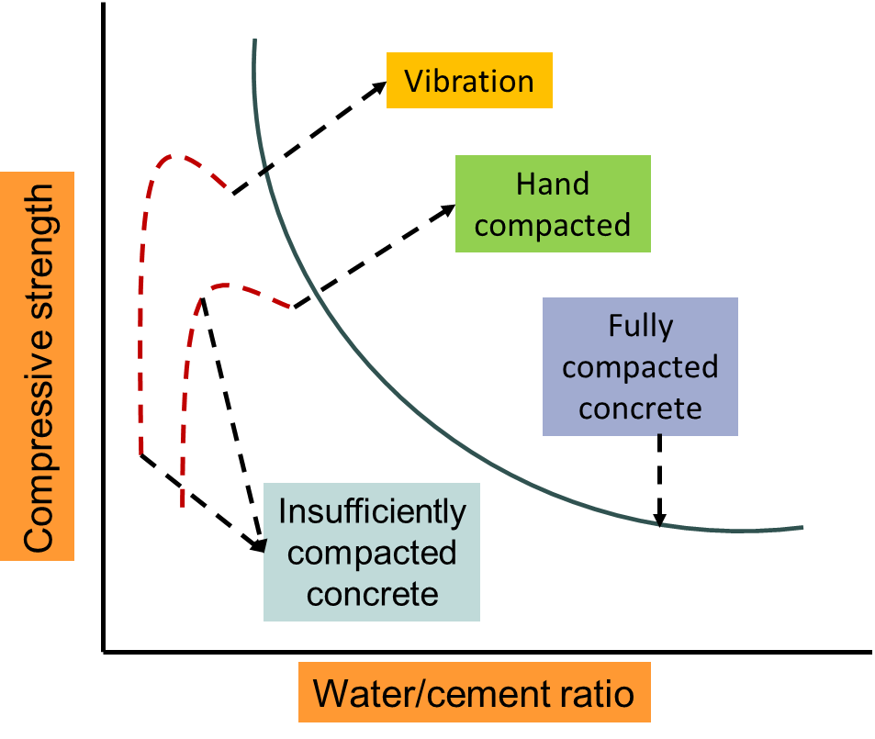
Workability Vs. Strength of Concrete

Slide 22
5 Tests to Measure the Workability of Concrete
Slump Test
Compacting Factor Test
Flow Test
Vee-Bee Consistometer Test
Kelly Ball Test

Slide 23
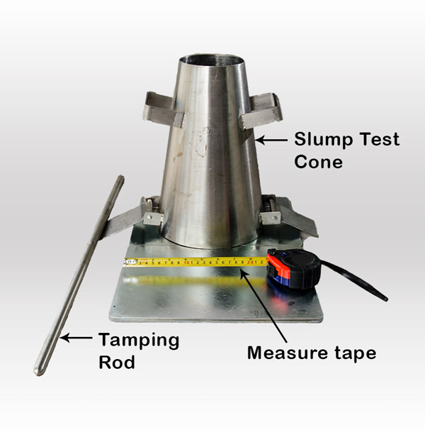
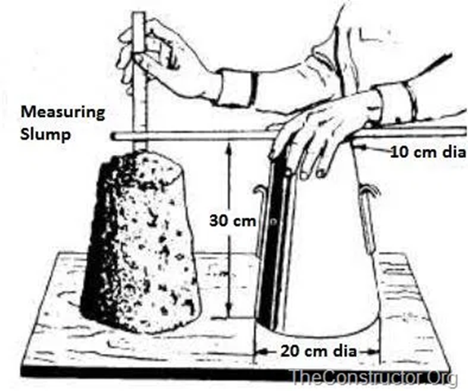
Slump Test:

Slide 24
The concrete slump test or slump cone test is the most common test for workability of freshly mixed concrete which can be performed either at the working site/field or in the laboratory.
To maintain the workability and quality of fresh concrete, it is necessary to check batch by batch inspection of the concrete slump. This can be easily done with the concrete slump test.
The slump test is the simplest test to determine workability of concrete that involves low cost and provides immediate results.

Slide 25
Recommended Result of Concrete Slump Test:
As per IS 456:2000 (Plain and Reinforced Concrete -Code of Practice),
If the slump of the concrete is in between 0 to 25 mm than it is considered as very low workability of concrete,
If the slump of the concrete is in between 25 to 50 mm than it is considered as low workability of concrete,
If the slump of the concrete is in between 50 to 100 mm than it is considered as medium workability of concrete,
If the slump of the concrete is in between 100 to 150 mm than it is considered as high workability of concrete.

Slide 26
Recommended Values of Concrete Slump Tests for Various Purposes:
No. | Types of concrete | Slump
1 | Concrete for road construction | 20 to 40 mm
2 | Concrete for tops of curbs, parapets, piers, slabs and wall | 40 to 50 mm
3 | Concrete for canal lining | 70 to 80 mm
4 | Normal RCC work | 80 to 150 mm
5 | Mass concrete | 20 to 50 mm
6 | Concrete to be vibrated | 10 to 25 mm

Slide 27
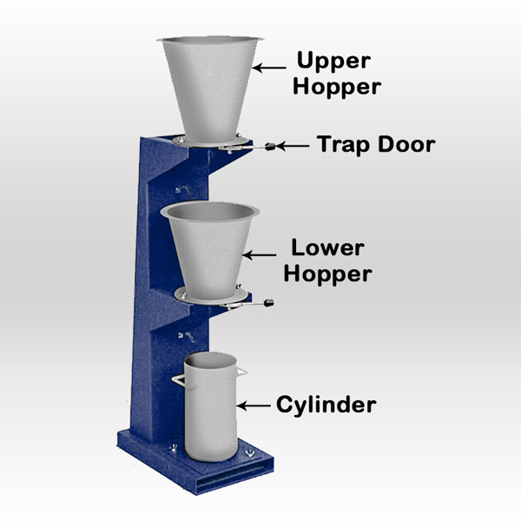
Compaction Factor Test:
Compaction factor test works on the principle of determining the degree of compaction achieved by a standard amount of work done by allowing the concrete to fall through a standard height.

Slide 28
This is specially designed for laboratory use, but if the circumstances favours, it can also be used on the working site/field.
Compaction factor test of concrete is more precise and sensitive than the concrete slump test; hence it is more favorable and useful for low workable concrete or dry concrete which is generally used when concrete is to be compacted by vibration.

Slide 29
Recommended Result of Compaction Factor Test:
According to the ‘A.M. Neville’ (Author of Properties of Concrete), description of the degree of workability and their compacting factor are as follows:
If the compacting factor is 0.78 than it is considered as very low workability of concrete,
If the compacting factor is 0.85 than it is considered as low workability of concrete,
If the compacting factor is 0.92 than it is considered as medium workability of concrete,
If the compacting factor is 0.95 than it is considered as high workability of concrete.

Slide 30
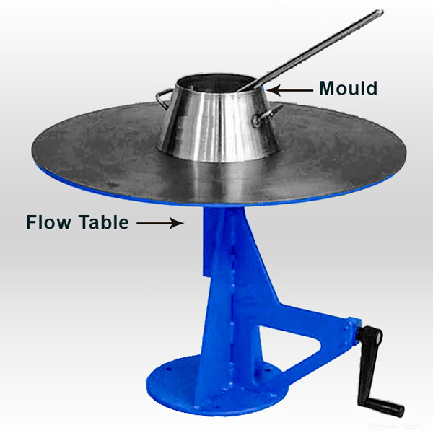
Flow Test:
The flow test is a laboratory test, which gives an indication of the quality of concrete with respect to consistency or workability and cohesiveness. In the flow test, a standard mass of concrete is subjected to jolting. This test is generally used for high/ very high workability concrete.

Slide 31
Similar laboratory test named ‘Flow Table Test ‘was developed in Germany in1933 and it has been described in ‘BS 1881:105: 1984’. This method is used for the high and very high workable concrete which would exhibit the collapse slump.
Recommended Result of Flow Test
According to ‘M.S. Shetty’ (Concrete Technology Theory and Practice), the value of flow test may range anything from 0 to 150 %.

Slide 32
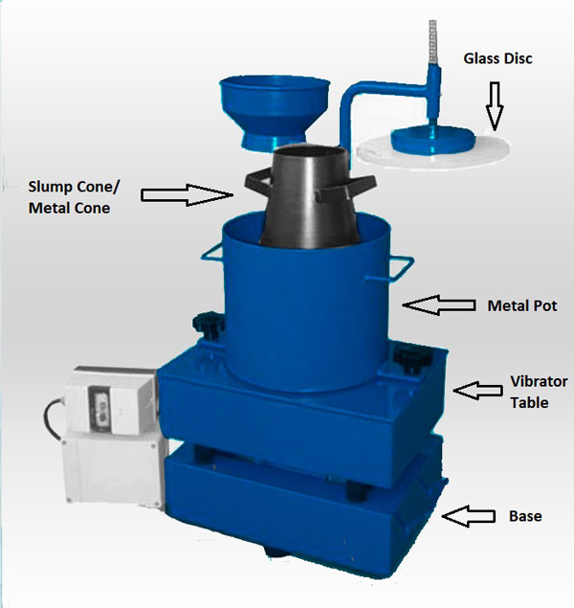
Vee Bee Consistometer Test:
Vee bee consistometer test is a good laboratory test on fresh concrete to measure the workability in an indirect way by using a Vee-Bee consistometer.
Vee bee test is usually performed on dry concrete and it is not suitable for very wet concrete.
Vee bee consistometer test determines the mobility and to some extent compatibility of concrete.
In the vee bee consistometer test vibrator is used instead of jolting. Vee bee test determines the time required for the transformation of concrete by the vibration.

Slide 33
Recommended Result of Vee Bee Consistometer Test
According to ‘IS 1199:1959’ (Methods of Sampling and Analysis of Concrete),
If vee bee time is up to 20 to 15-10 seconds than concrete is considered as in a very dry consistency.
If vee bee time is up to 10 to 7-5 seconds than concrete is considered as in a dry consistency.
If vee bee time is up to 5 to 4-3 seconds than concrete is considered as in a plastic consistency.
If vee bee time is up to 3 to 2-1 seconds than concrete is considered as in a semi-fluid consistency.

Slide 34
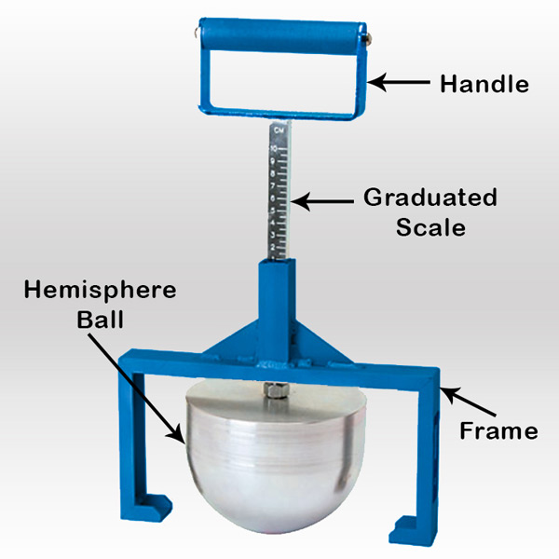
Kelly Ball Test (Ball Penetration Test):

Slide 35
This test is developed by J.W Kelly, hence it’s known as a Kelly ball test.
Kelly ball test is a simple and inexpensive field test which measures workability of fresh concrete with the similar to the concrete slump test, but it is more accurate and faster than a slump test.
This test uses a device that consist of metal hemisphere (ball) thereby indicating the consistency of fresh concrete by its level of penetration when the metal hemisphere drops.
Thus, in this test, depth is determined through metal hemisphere, which sinks under its own weight into fresh concrete.

Slide 36
SEGREGATION AND BLEEDING

Slide 37
SEGREGATION IN CONCRETE:
Segregation is the “Separation of constituent materials in concrete.” In concrete technology, segregation is of three types:-
Separation of Coarse aggregate from the concrete mixture,
Separation of Cement pastes from the concrete during its plastic stage.
Separation of water from the concrete mix (Bleeding in concrete)

Slide 38
Concrete is a mixture of Cement, fine and coarse aggregates.
A good concrete is one in which all the constituents are properly categorized to form a homogeneous mixture.
The primary cause of Segregation in concrete is the differences in specific gravities of the constituents, Specific gravity of Cement is in between 3.1-3.6g/cc, and for aggregate it lies between 2.6-2.7g/cc due to this differences, the aggregate separates from the matrix and causes segregation in concrete.

Slide 40
Some other factors causing segregation in concrete:
Transporting concrete mixes for long distances.
Poorly proportioned mix, where sufficient matrix is not there to bind the aggregates.
Dropping concrete from more than 1m.
Vibrating concrete for a long time.

Slide 41
How to minimize segregation in concrete:-
Segregation can be controlled by maintaining proper proportioning the mix.
By peculiar handling, placing, transporting, compacting and finishing of concrete.
Adding air entraining agents, admixtures and pozzolanic materials in the mix, segregation controlled to some extent.

Slide 42
BLEEDING:
Bleeding is a form of segregation in which water present in the concrete mix is pushed upwards due to the settlement of cement and aggregate.
The specific gravity of water is low, due to this water tends to move upwards. Bleeding ordinarily occurs in the wet mix of concrete.
The Prime factor for bleeding in concrete is the high dosage of Water cement ratio. Higher water-cement ratio weakens concrete and leads to excessive bleeding.

Slide 43
The bleeding in concrete is not harmful if the rate of evaporation of water is equal to the rate of bleeding. Normal bleeding is quite good, and it enhances the workability of concrete.
When the concrete is fully plastic, bleeding may not cause much harm. However, concrete is still in the plastic stage later it is subsidized and compacted.

Slide 44
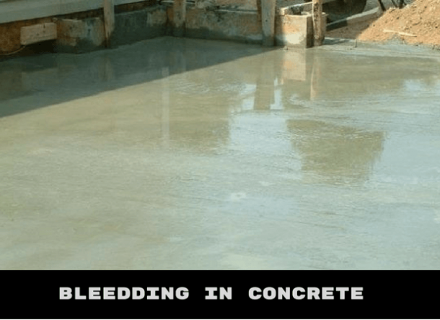

Slide 45
How bleeding effects concrete stability:-
As mentioned above, water move upwards in bleeding, sometimes with this water certain amount of cement moved along with water to the concrete surface.
When the top surface is worked up with the trowel, the aggregate goes down and cement paste forms at the top surface this is called ‘Laitance in concrete.’ Due to the formation of Laitance, structures may lose its wearing capacity and decreases its life.

Slide 46
Water while moving from bottom to the top, forms continuous channels. Due to this channels, concrete becomes permeable and allow water to move, which forms water voids in the matrix and reduces the bond between aggregate and the cement paste.
Forming of water at the top surface of concrete results in delaying the surface finishing.
Concrete becomes permeable and loses its homogeneity.
Excessive bleeding breaks the bond between the reinforcement and concrete.

Slide 47
How the bleeding in concrete is controlled:-
Bleeding in concrete is controlled by Adding minimum water content in the concrete mix.
Encouraging the use of air en-training admixtures in the mix.
By adding more cement in the mix.

Slide 48

What does Laitance mean?
A laitance is a weakened layer of cement and fine particles on a concrete surface caused by a excessive level of undesired moisture or poor cement finishing.

Slide 49
Corrosionpedia explains Laitance
A laitance can be a contributing factor of corrosion. When metallic structures are adhered to or placed on a cement foundation with a laitance present, moisture can be trapped between the concrete and the metal surface, causing crevice corrosion or pitting.

Slide 50
CONCRETE LAITANCE
Concrete laitance is a layer of weak and nondurable cement and fine particles originated from aggregate.
These materials are moved upward due to movement of moisture (bleeding) through concrete because of the presence of too much mixing water.

Slide 51
The quantity of cement and fine particles (concrete laitance layer) increases due by overworking or over manipulating concrete at the surface, by improper finishing or by job traffic..
So, laitance comes in varying degrees of thickness, from a fine dust to several millimeters or more, based on contributing factors

Slide 52
Causes of Concrete Laitance:
Too much mixing water
Overworking or over manipulating concrete surface
Improper finishing
Job traffic
Poor curing regime

Slide 53
Methods of Concrete Laitance Removal:
The removal of laitance is important to ensure that materials applied to the floor such as painting and coating adhere to it adequately.
There are several ways to remove laitance and the method chosen should depend on the working environment and purpose of the floor.

Slide 54
1. Shot Blasting Method:
Shot blasting is assumed to be fast and efficient laitance removal technique. It involves firing abrasive elements on the concrete surface at a high velocity.
Moreover, it is estimated that, shot blasting technique clean minimum area of 1000 square meters per single day.

Slide 55
Shot blasting is a dry process which is an advantage since floor laying might be continue in other area of the room during shot blasting process.
Lastly, it is considered as far quicker, quieter and cleaner than other methods such as mechanical planing, scabbling, etc.

Slide 56
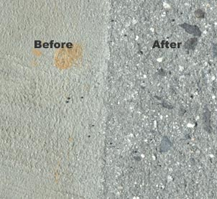

Slide 57


Slide 58
2. Mechanical Planning Method:
Mechanical planning, which is also termed as concrete planning, is utilized to remove greater thickness of concrete laitance.
The machine carries rows of rotating tungsten-tipped cutters to provide an excellent removal of laitance.

Slide 59
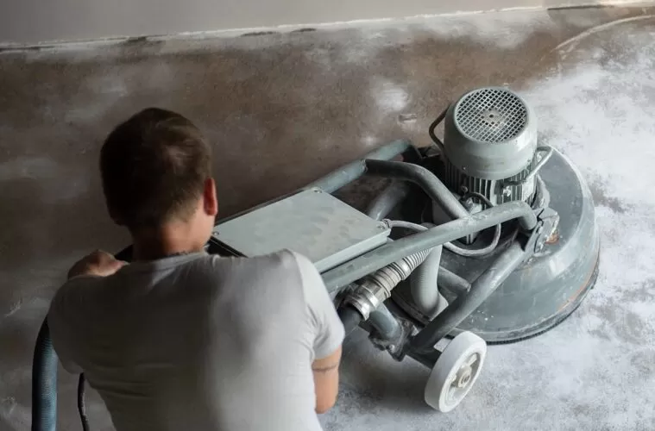

Slide 60
3. Scabbling Method:
This process is often used on outdoor projects including on concrete roads. Vibrating floor scabbing machines are used to impact the concrete to break the laitance surface.
Typically, you wouldn’t use this method indoors or on a smaller surface area. Scabbing can be noisy, dirty and very dusty. It tends to be used where the concrete layer is thicker than 10mm. Anything less and you face damaging your actual screed layer.

Slide 61

4. Grinding Method:
This method is used for smaller areas and edges. Handheld grinding machines, designed for precision, control and safe operation to remove concrete laitance

Slide 62
5. Acid Etching Method:
This method is employed for very thin concrete laitance and non-porous or low porous surface.
The acid attacks and breaks down the top surface and it is a very effective method.
This should only be used if other options have been ruled out.

Slide 63
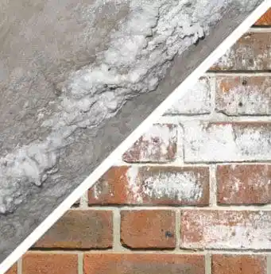
Concrete Laitance Versus Efflorescence
Laitance and efflorescence are totally different, but both are white and powdery materials. the difference between laitance and efflorescence are summarized

Slide 64
Concrete Laitance | Efflorescence
Laitance is formed when there’s too much water in the concrete mix | It is the deposit on concrete surfaces caused by soluble salts in concrete.
Can be avoided by controlling the amount of water in the concrete mix | Can be prevented, or minimized, through selecting materials free of harmful salts and by preventing water from penetrating the concrete.
Removal methods include shot blasting, mechanical planning, scabbling, grinding, acid etching, and abrading method | Removal technique involves pressurized water, sand ballasting, and chemical acid cleaning.

Slide 65
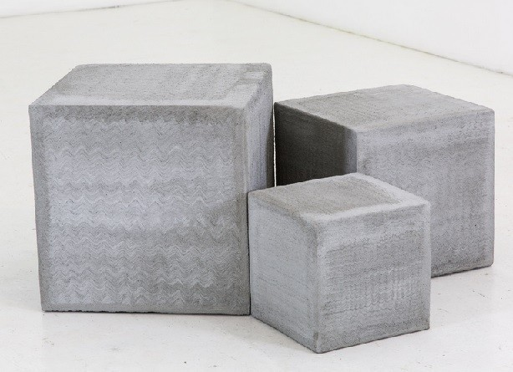
Hardened Concrete

Slide 66
Strength of Concrete
Strength of concrete is commonly considered its most valuable property, although in many practical cases, other characteristics, such as durability and permeability may in fact be more important.
Strength usually gives an overall picture of the quality of concrete because strength is directly related to the structure of the hydrated cement paste.
Strength of concrete could be defined as the ultimate load that causes failure (or is its resistance to rupture) and its units are force units divided by area (N/mm2).

Slide 67
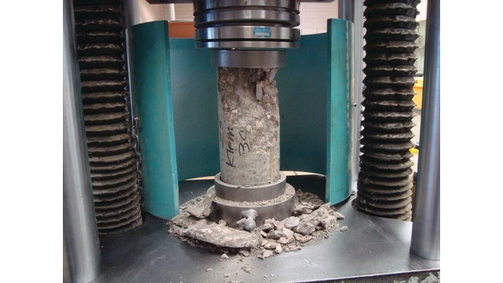
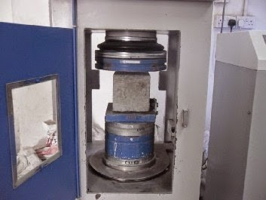


Strength of Concrete

Slide 68

Strength of Concrete
Characteristic strength - Compressive, Tensile and Flexure strength
Modulus of Elasticity
Creep and shrinkage of concrete
THE THREE S-WORDS
Stress: a weight or load applied to the concrete (in N)
Strength: the concrete’s ability to carry the weight or load (in N per square mm)
Strain: how much the concrete stretches or compresses (deforms) when carrying a load (in inches per mm)

Slide 69
Types of Concrete Strength
Compressive Strength
Tensile Strength
Shear Strength
Bond Strength
Impact Strength
Fatigue Strength

Slide 70
Compressive Strength
The compressive strength of concrete is defined as the strength of 28days old specimens tested under monotonic uniaxial compressive load.
Testing of cylindrical samples with 15cm diameter and 30cm height is standard.
Cube specimens of 15cm × 15cm × 15 cm are also being used.
Normally, the compressive strength of concrete is determined by testing and the tensile strength and modulus of elasticity are expressed in terms of the compressive strength.

Slide 71
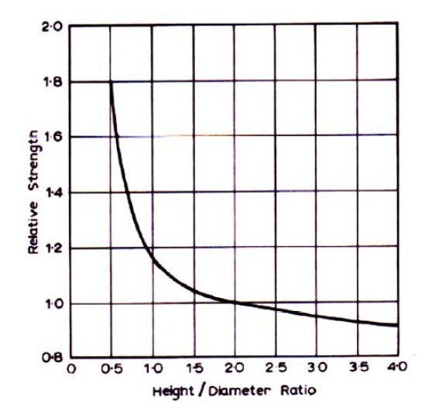
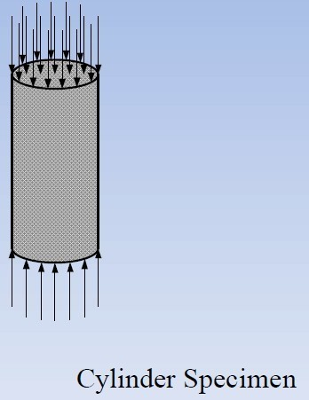
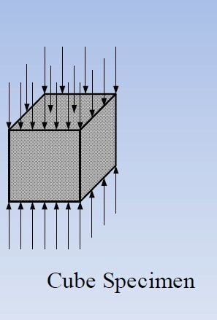
Compressive Strength

Slide 72
Compressive Strength
There are three failure modes for cylinders.
Under axial compression concrete fails in shear.
The separation of the specimen into columnar pieces by what is known as splitting or columnar fracture.
Combination of shear and splitting failure.

Slide 73
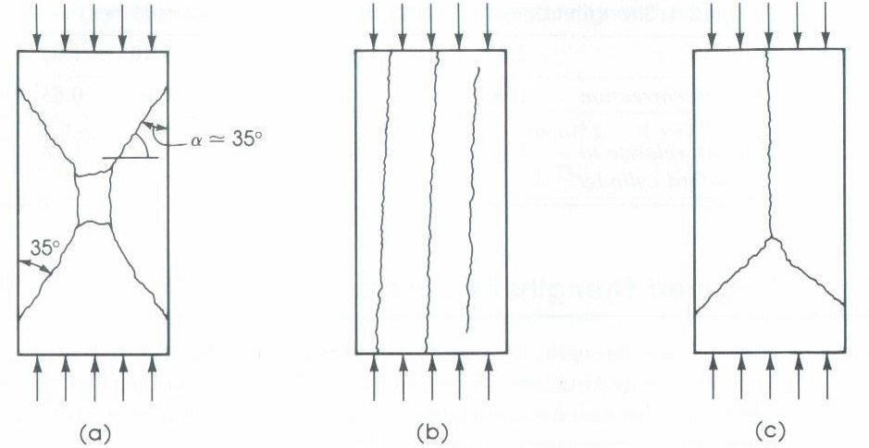
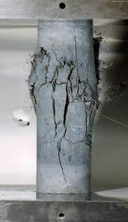

Slide 74
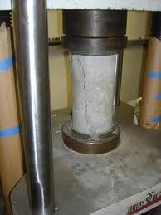
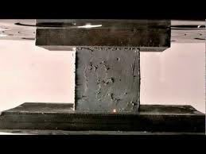

Slide 75
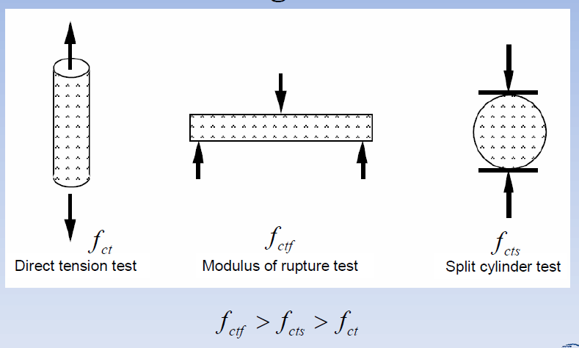
Tensile Strength of Concrete:
The tensile strength of concrete is much lower than the compressive strength, largely because of the ease with which cracks can propagate under tensile loads
The tensile strength of concrete is measured in three ways:
Direct tension,
Splitting tension, and
Flexural tension

Slide 76
Tensile Strength of Concrete
It is difficult to test concrete in direct (uniaxial) tension because of the problem of gripping the specimen satisfactorily and because there must be no eccentricity of the applied load. Therefore, direct tensile test is not standardized and rarely used.
Modulus of rupture test and splitting test are commonly used to determine the tensile strength of concrete

Slide 77
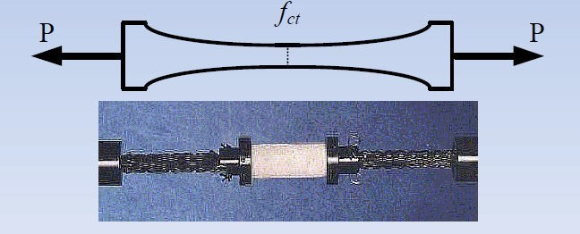
Tensile Strength of Concrete
Direct-Tension Test:
The most direct way of measuring the tensile strength.
Not a practical test.

Slide 78
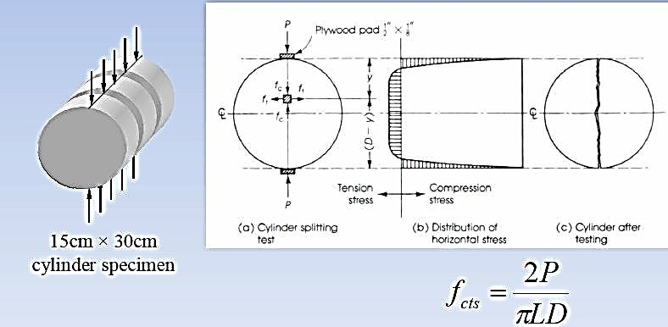
Tensile Strength of Concrete
•
Split-Cylinder Test:

Slide 79
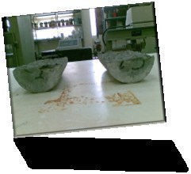
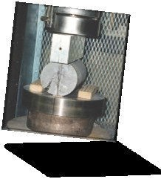
Split Cylinder Test

Slide 80
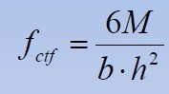
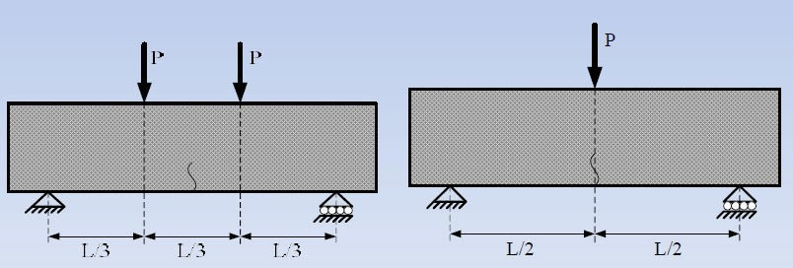
Tensile Strength of Concrete
Modulus of Rupture Test:
Four-point bending (two-point loading)
Three-point bending (third point loading)

Slide 81
Relationship Between Compressive and Tensile Strength of Concrete
Tensile strength of concrete is proportional to the squareroot of the compressive strength.
The proportionality constant depends on many factors, such as the concrete strength and the test method used to determine the tensile strength.

Slide 82
Concrete Strength
Shear Strength
Shear strength of concrete is taken approximately equal to 20 % its compressive strength

Slide 83
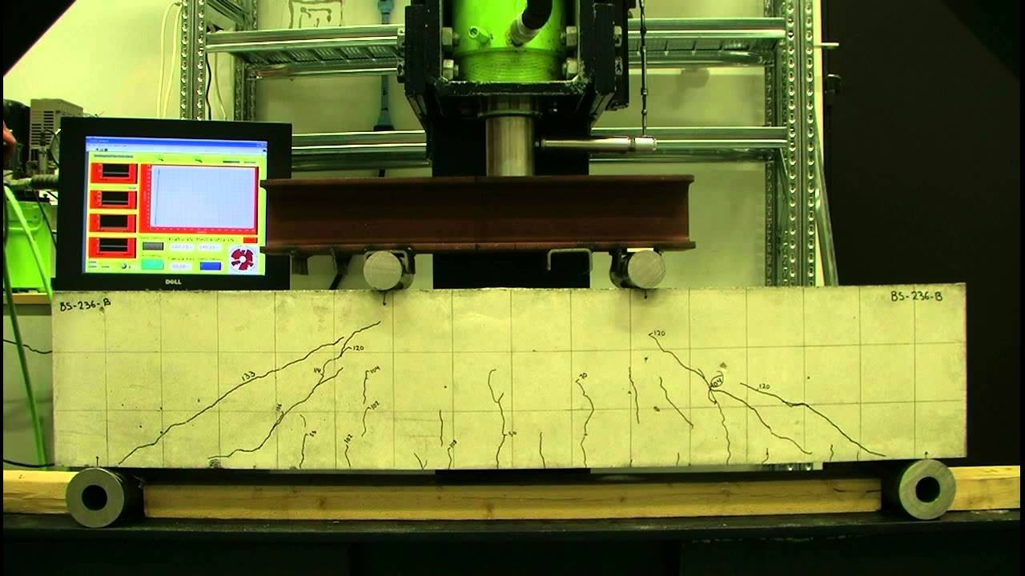
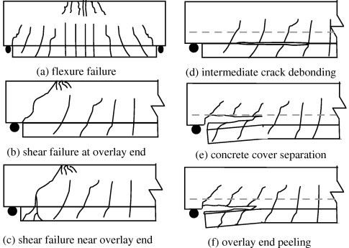
Shear Strength

Slide 84
Bond Strength:
The strength of bond between steel reinforcement and concrete is called as bond strength of concrete
Bond strength develops primarily due to friction and adhesion between steel reinforcement and concrete
In general, bond strength is approximately proportional to compressive strength of concrete up to about 20MPa

Slide 85
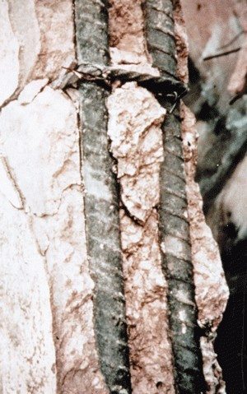
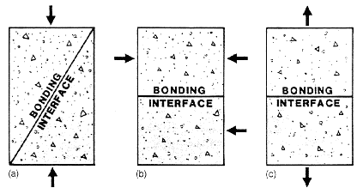
Bond Strength

Slide 86
Concrete Strength(Impact Strength):
Impact strength of concrete is of importance in driving concrete piles, in foundations for machines exerting impulsive loading, and also when accidental impact is possible, e.g. when handling precast concrete members.
There is no unique relation between impact strength another strengths of concrete.
However, some researchers have found that impact is related to the compressive strength, and it has been suggested that the impact strength varies from 0.50 to0.75 of the compressive cube strength

Slide 87
Concrete Strength
Fatigue Strength
The strength of concrete against cyclic or repeated loading is called as its fatigue strength

Slide 88
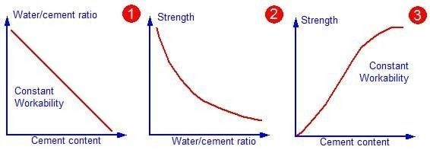
Factors affecting strength of concrete
Water/cement ratio and degree of compaction
Ratio of cement to aggregate
Grading, surface texture, shape, Strength an stiffness of aggregate particles
Maximum size of aggregate.

Slide 89
Water/cement ratio and degree of compaction:
Strength of concrete primarily depends upon the strength of cement paste.
The strength of cement paste depends upon the dilution of paste or in other words, the strength of paste increases with cement content and decreases with air and water content.
In 1918; Abrams’ law states that “assuming full compaction, and at a given age and normal temperature, strength of concrete can be taken to be inversely proportional to the water/cement ratio”

Slide 90

Abrams’ law
Abrams' law (also called Abrams' water-cement ratio law) is a concept in civil engineering. The law states the strength of a concrete mix is inversely related to the mass ratio of water to cement. As the water content increases, the strength of concrete decreases.
Abrams’ law is a special case of a general rule formulated empirically by Feret:
where:
S is the strength of concrete
A and B are constants
w/c is the water–cement ratio, which varies from 0.3 to 0.6
σ or S = $\frac{A}{Bw⁄c}$

Slide 91
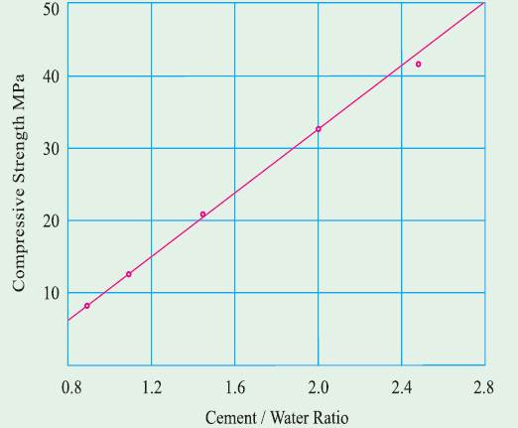
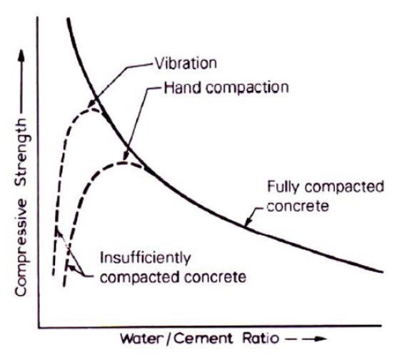
Water/cement ratio and degree of compaction
Water/Cement Ratio: Typically: 0.35 – 0.45
Smaller w/c ratio → stronger concrete

Slide 92
Gel/Space Ratio
Since concrete is a brittle material, its porosity primarily governs its strength. The compressive strength is found to be severely decreasing with increase in the porosity.
The porosity of concrete which governs the strength of concrete is affected by the gel/space ratio in concrete.
The gel/space ratio is the ratio of the solid products of hydration to the space available for these hydration products.
A higher gel/space ratio reduces the porosity and therefore increases the strength of concrete

Slide 93
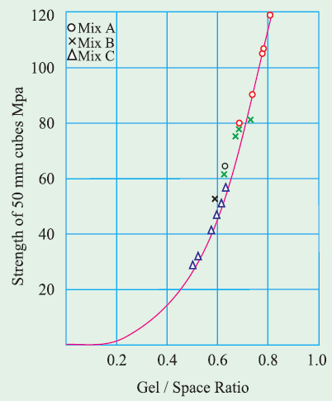
Gel/Space Ratio
The gel/space ratio, which governs the porosity of concrete affecting its strength, is affected by the water/cement ratio of concrete
A higher water/cement ratio decreases the gel/space ratio increasing the porosity thereby decreasing the strength of concrete.

Slide 94
Influence of Aggregate/Cement Ratio:
The aggregate/cement ratio, is only a secondary factor in the strength of concrete but it has been found that, for a constant water/cement ratio, a leaner mix leads to a higher strength.
Some water may be absorbed by the aggregate: a larger amount of aggregate absorbs a greater quantity of water, the effective water/cement ratio being thus reduced.

Slide 95
A higher aggregate content would lead to lower shrinkage and lower bleeding, and therefore to less damage to the bond between the aggregate and the cement paste.
As a result, in a leaner mix, the voids form a smaller fraction off the total volume of concrete, and it is these voids that have an adverse effect on strength

Slide 96
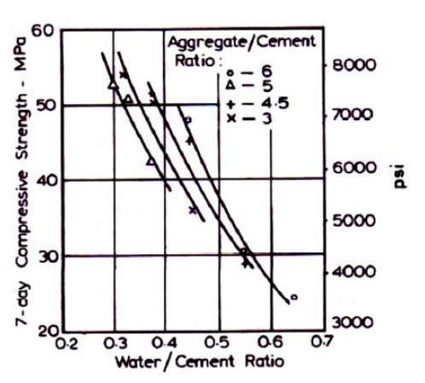
Influence of Aggregate/Cement Ratio:

Slide 97
Effect of Maximum size of Aggregate
The larger the aggregate the lower is the total surface area and, therefore, lower is the requirement of water for the given workability.
The use of larger size aggregate did not contribute to higher strength as expected from the theoretical considerations due to the following reasons.

Slide 98
The larger maximum size aggregate gives lower surface area for developments of gel bonds which is responsible for the lower strength of the concrete.
Secondly bigger aggregate size causes a more heterogeneity in the concrete which will prevent the uniform distribution of load when stressed.
When large size aggregate is used, due to internal bleeding, the transition zone will become much weaker due to the development of micro cracks which result in lower compressive strength.

Slide 99
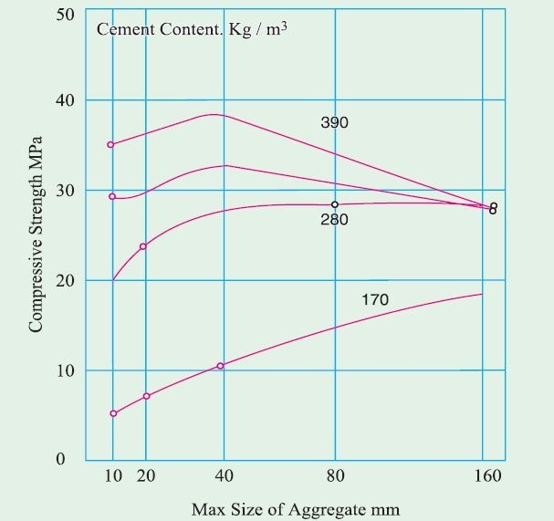
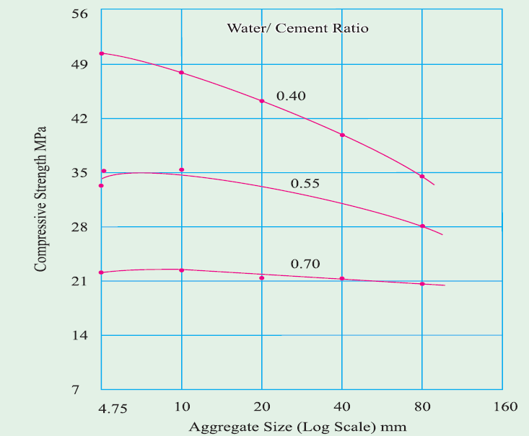
Effect of Maximum size of Aggregate

Slide 100
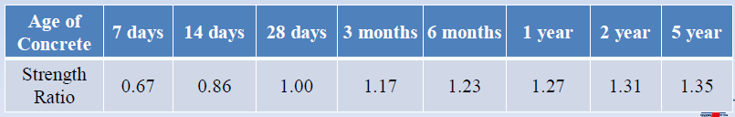
Age of Concrete
With an increase in age, the degree of hydration generally increases the gel/space ratio so that strength increases.
Increase in the strength of concrete (at same w/c ratio)with increase in early age (from 1 to 28 days) of concrete.

Slide 101
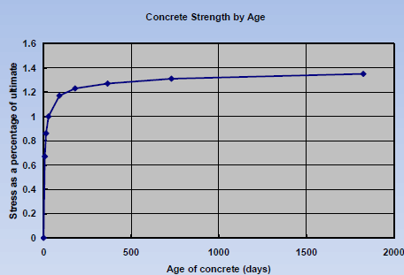
Age of Concrete

Slide 102
Influence of Properties of Coarse Aggregate
The relation between the flexural and compressive strengths depends on the type of coarse aggregate because the properties of aggregate, especially its shape and surface texture, affect the ultimate strength in compression very much less than the strength intension or the cracking load in compression.
In experimental concrete, entirely smooth coarse aggregate led to a lower compressive strength, typically by 10 per cent, than when roughened.
The influence of the type of coarse aggregate on the strength of concrete varies in magnitude and depends on the water/cement ratio of the mix.

Slide 103
For water/cement ratios below 0.4, the use of crushed aggregate has resulted in strengths up to 38 percent higher than when gravel is used.
With an increase in the water/cement ratio to 0.5,influence the of aggregate falls off, presumably because of the strength the hydrated cement paste itself becomes paramount and, at a water/cement ratio of 0.65, no difference in the strengths of concretes made with crushed rock and gravel has observed.

Slide 104
Influence of Temperature on Strength
The rise in the curing temperature speeds up the chemical reactions of hydration and thus affects beneficially the early strength of concrete without any ill-effects on the later strength.
Rapid initial hydration appears to form products of a poorer physical structure, probably more porous, so that a proportion of the pores will always remain unfilled.
The gel//space ratio rule that this will lead to a lower strength compared with a less porous, though slowly hydrating, cement paste in which a high gel//space _ratio will eventually be reached.

Slide 105
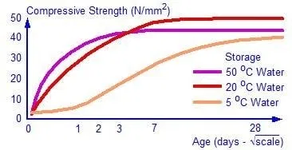

Slide 106
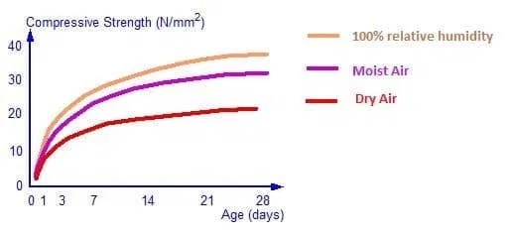

Slide 107
Fatigue Strength of Concrete
Modulus of Elasticity,
Creep
Shrinkage of concrete

Slide 108
Stress-Strain Plot of Concrete
At stress below 30% of ultimate strength, the transition zone cracks remain stable. The stress-strain plot remains linear.
At stress between 30% and 50% of ultimate strength, the transition zone micro-cracks begin to increase in length, width and numbers. The stress-strain plot becomes non-linear.
At 50 to 60% of the ultimate stress, cracks begin to form in the matrix.
With further increase to about 75% of the ultimate stress, the cracks in the transition become unstable, and crack propagation in the matrix will increase. The stress- strain curve bends towards the horizontal.

Slide 109
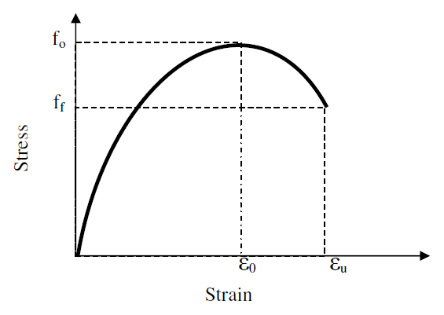
Stress-Strain Plot of Concrete
At 75 to 80% of the ultimate stress, the stress reaches a critical stress level for spontaneous crack growth under a sustained stress. Cracks propagate rapidly in both the matrix and the transition zone. Failure occurs when the cracks join together and become continuous.
Concrete is not a truly elastic material, as evident from the nonlinear stress-strain curve for concrete shown in the fig.

Slide 110
Stress-Strain Plot of Concrete
The “initial tangent modulus” is given by the slope of a line drawn tangent to the stress-strain curve at the origin
The “tangent modulus” is given by the slope of a line drawn tangent to the stress-strain curve at any point on the curve
The “secant modulus” is given by the slope of a line drawn from the origin to a point on the curve corresponding to a 40% stress of the failure stress
The “secant modulus” is given by the slope of a line drawn from the origin to a point on the curve corresponding to a 40% stress of the failure stress

Slide 111
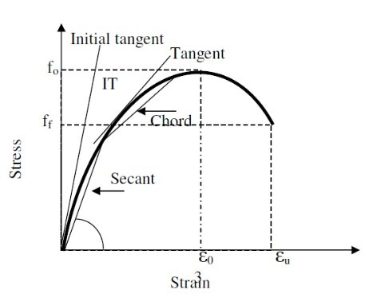
Stress-Strain Plot of Concrete

Slide 112
Determination of modulus of elasticity of Concrete
Testing of cube or cylinder in uniaxial compression test.
Measure load and the corresponding deformation as the load is increased. Draw the stress strain curve.
Strain =Dial gauge reading/gauge length = dl/L
Stress = Load/Cross sectional area= P/A
Use Compressometer and Extensometer to measure deformations. Draw stress strain diagram and determine the required modulus.
Deflection: E can be determined from testing of beam also.

Slide 113
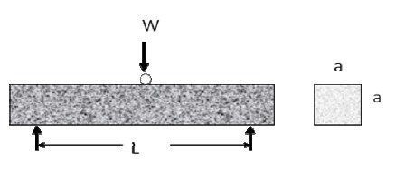
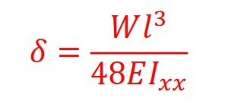
Determination of Modulus of Elasticity

Slide 114

Determination of modulus of elasticity
The test uses a 150 X 300 mm cylindrical specimen, which is loaded in compression. A compress meter is used to measure the longitudinal strains, and an extensometer is used to measure the transverse strains on the specimen.
The chord modulus (E) is calculated as:
Where
S2 = stress corresponding to 40% of ultimate strength
S1 = stress corresponding to a strain of 50 X 10⁻⁶
Ε2 = longitudinal strain produced by stress S2

Slide 115

Poisson’s ratio (Static Method)
When a material is compressed in one direction, it usually tends to expand in the other two directions perpendicular to the direction of compression. This phenomenon is called the Poisson effect.
The Poisson ratio is the ratio of the fraction (or percent) of expansion divided by the fraction (or percent) of compression, for small values of these changes. μ = 0.15 - 0.20
– Actual value to be found from strain measurements on concrete cylinder using extensometer.
where ε_{t2},ε_{t1}= transverse strains produced by S₂& S₁, respectively

Slide 116



Relation between Modulus of Elasticity and Strength
Modulus of elasticity of concrete increases approximately with the square root of the strength. The IS 456 of 2000 gives the Modulus of elasticity as

Slide 117
Factors Affecting Modulus of Elasticity of Concrete
Effects of moisture condition
Specimens tested in dry condition show
about 15%
decrease in elastic modulus as compared specimens. This is explained by the fact
to the wet
that
drying
produces more micro-cracks in the transition zone, which affects the stress-strain behavior of the concrete.
This is opposite to its effects on compressive strength. The compressive strength is increased by about 15% when tested dry as compared with the wet specimens

Slide 118
Factors Affecting Modulus of Elasticity of Concrete
Effects of Aggregate properties
Porosity of aggregate has the most effect on the elastic modulus of concrete. An aggregates with a low porosity has a high modulus of elasticity.
The elastic modulus of concrete is affected by the volume fraction of the aggregate as well as the elastic modulus of the aggregate.

Slide 119
Factors Affecting Modulus of Elasticity of Concrete
Effects of cement matrix
•
The lower the porosity of the cement paste, the hight the elastic modulus of the cement paste.
•
The higher the elastic modulus of the cement paste, the higher the elastic modulus of the concrete.
•
Effects of transition zone
•
The void spaces and and the micro cracks in the transition play a major role in affecting the stress-strain behavior of concrete.
•
The transition zone characteristics affect the elastic modulus more than it affects the compressive strength of concrete.

Slide 120
Creep
The ability of concrete to creep imparts a degree of ductility to concrete that enables it to tolerate the normal range of structural deformations encountered in practice.
Creep provides a structure with the ability to redistribute excessive stresses.
Without the ability to creep, concrete would simply be too brittle for use in the majority of structures. However, creep also may have detrimental effects such as increased deflection resulting in cracking, loss of prestress, and buckling of slender columns.
It is therefore important that the designer takes the necessary steps to allow for creep in the design of concrete structures.

Slide 121

Creep

Slide 122

Definition
Creep is defined as the increase in strain (deformation) under a sustained stress (load). When loaded, concrete experiences an instantaneous elastic strain, which is recoverable. In addition, an inelastic creep strain takes place that is only partially recoverable

Slide 123

Creep
Test methods
Creep is usually determined by measuring the change in strain with time of a specimen subjected to a constant stress and stored under appropriate conditions.

Slide 124

Creep

Slide 125

Factors Influencing Creep
Factors Influencing creep
Creep of concrete is load induced, and is inﬂuenced by factors associated with the application of load and the ability of the concrete to withstand the load.
The potential of the concrete to creep is determined by mix materials and proportions of the concrete. The cement paste creeps, and the role of the aggregate is to:

Slide 126

Stress Strain Ratio
Creep is linearly proportional to the stress: strength

Slide 127
Cement Paste Content
Cement paste content Hardened Concrete
A 1% increase in cement paste by volume will result in approximately a 5% increase in creep. This is applicable for concretes with a cement paste volume paste volume of 28% to 40%.
The cement paste volume is inﬂuenced by the aggregate content of the mix: the greater the aggregate content, the lower the cement paste content

Slide 128
Cement Type
Cement Type
The type of cement inﬂuences the strength development of concrete. A high stress: strain ratio could potentially result if the concrete is loaded at an early age and the cement has a slow rate of strength development.

Slide 129

Durability
The durability of a structure may be deﬁned as the time for which the structure can fulﬁll the function for which it was designed and constructed.

Slide 130
Durability
•
Defined as its resistance processes to deterioration processes that may occur as a result of interaction with its environment (external) or between the constituent materials of their reaction with contaminants present (internals).
Ability to with stand the damaging effects of the environment over a long period of time.
The absence of durability maybe caused either by the environment to which the concrete is exposed i.e. external or internal causes.
•
•

Slide 131
Factors Influencing Durability
The following factors are of equal importance in inﬂuencing the durability of a concrete structure:
The achievement of structural durability requires
the designer, contractor, supervisory engineer and materials
rigorous attention to detail by
engineer. Even if the highest possible grades of concrete are supplied, the structure will only be durable if good practice prevails in all phases of the building project.

Slide 132
Factors Influencing Durability
•
To accurately predict cracking, concrete properties such as shrinkage creep are considered
Member Shapes complicating concrete compaction and thin concrete section are avoided
Ponding of water is prevented, Rain and sea water drained away from structure.
No ingress of water can occur into joints.
Correct curing time and methods are specified
•
•
•
•

Slide 133

Durability

Slide 134
Durability is Achieved By
Well Compacted Concrete
Good workmanship reduced porosity
Use of aluminosulphate resisting cement , Portland blast furnace slag, or Portland pozzolana cement.
Sufficient cover over reinforcement
Use of low water cement Ratio

Slide 135
Shrinkage
Shrinkage cracks in concrete occur due to change in moisture of concrete. Most of the building materials like concrete, mortar, burnt clay bricks are porous in their structure in the form of inter-molecular space. They expand when they absorb the moisture and shrink when they dry. This is the main cause the concrete shrinks on drying. Shrinkage of concrete is an irreversible process.

Slide 136

Shrinkage

Slide 137
Shrinkage
Concrete shrinkage can become problematic when doing any type of construction, but especially when dealing with floors. Concrete shrinkage is the contracting of the concrete due to the water evaporating from the mixture. This evaporation will cause the concrete to weaken. This can lead to cracks, internal warping and external deflection

Slide 138

Shrinkage

Slide 139
Shrinkage
Types of Concrete Shrinkage
There are
numerous types of
plastic shrinkage,
concrete
drying
shrinkage
shrinkage,
including
autogenous shrinkage, and carbonation shrinkage.
Plastic shrinkage happens soon after the concrete is poured in the forms. The water evaporates and results in a reduction of volume, this causes the concrete on the surface to collapse. It can be reduced by covering the surface with polyethylene sheeting immediately after it is poured.

Slide 140


Plastic Shrinkage

Slide 141
Shrinkage
Drying shrinkage is the ever lasting process for concrete within drying conditions. The loss of water within the gel pores of the concrete is what causes the concrete to shrink.
The finer the gel within the pores, the more shrinkage there is.
Autogenous shrinkage is most prevalent within the concrete in the interior of a dam. When the temperature is constant shrinkage may occur, especially when there is no moisture movement
Carbonation shrinkage is where carbon dioxide penetrates beyond the surface of the concrete. This also depends on the moisture content and the humidity levels. Carbonation shrinkage is caused by the disbanding of calcium hydroxide crystals and the evidence of calcium carbonate

Slide 142
Shrinkage

Slide 143
Shrinkage
Factors Affecting Shrinkage
There are so many factors that affect the shrinkage of concrete. The most important factor is the drying condition or the humidity in the atmosphere. No shrinkage will occur if the concrete is placed in one hundred percent relative humidity.
The shrinkage rate will decrease rapidly with time. It has been documented that fourteen to thirty-four percent of the twenty year shrinkage will occur within two weeks of it being poured. Within one year of the concrete being poured, shrinkage will be about sixty-six to eighty-five percent of the twenty year shrinkage

Slide 144
Shrinkage
The water to cement ratio will influence the amount of shrinkage that occurs.
The concrete’s richness also affects the shrinkage. The process of swelling and then drying affects the concrete’s integrity and the shrinkage.

Slide 145
Shrinkage
Factors affecting shrinkage are:
1. Aggregate -Concrete with higher aggregate
content exhibits smaller shrinkage. Concrete
with
aggregates of higher modulus of elasticity or of rougher surfaces is more resistant to the shrinkage process.
2. Water-cement ratio - The higher the W/C ratio
is, the higher the shrinkage. As W/C increases, paste strength and stiffness decrease; and as water content increases, shrinkage potential increases.

Slide 146
Shrinkage
Member size - Shrinkage decrease with an
increase in the volume of the concrete member However, the duration of shrinkage is longer for larger members since more time is needed for shrinkage effects to reach the interior regions.
Medium ambient conditions - The rate of
shrinkage is lower at humidity. Shrinkage
higher values becomes
of relative
at low
stabilized
temperatures.

Slide 147
Shrinkage
5. Admixtures - effect varies from admixture to
admixture. Any material which substantially changes the pore structure of the paste will affect the shrinkage characteristics of the concrete. In general, as pore refinement is enhanced, shrinkage is increased.

Slide 148
Permeability
•
Concrete has a tendency to be porous due to the presence of voids formed during or after placing.
Penetration by substance may adversely affect durability e.g. Ca(OH) ² leaches out.
Ingress of air and moisture resulting in corrosion. Important with regards to water tightness of liquid retaining structure.
•
•
•
•

Slide 149


Permeability

Slide 150

Permeability
To produce concrete of low permeability, full compaction & proper curing is essential.
Low permeability is important in increasing resistant to frost action and chemical attack and in protecting embedded steel against corrosion.

Slide 151
Permeability
The permeability of cement paste varies with the age of concrete or with progress of hydration.
With age, the permeability decreases because gel gradually fill the original water filled space.
For the same w/c ratio, the permeability of paste with coarser cement particles is higher than those with finer cement.
In general, the higher the strength of cement paste, the lower will the permeability.

Slide 152


Permeability

Slide 153
Permeability
Factors influencing permeability are:
W/C Ratio
Curing
Method of compaction
Workability
Soundness & porosity of the aggregate
Age (permeability decrease with age)
Grading of aggregate viii.Type of structure

